Slide 1



Delta Air Lines Safety Performance
By: Mithil Patel
Notes:
Greetings! My name is Mithil Patel, a Data Scientist at Delta Air Lines. On behalf of the Delta Air Lines family, I am here today to discuss an important topic, Airplane safety and how Delta dedicated to make air travel safe and reliable each day.

Slide 2

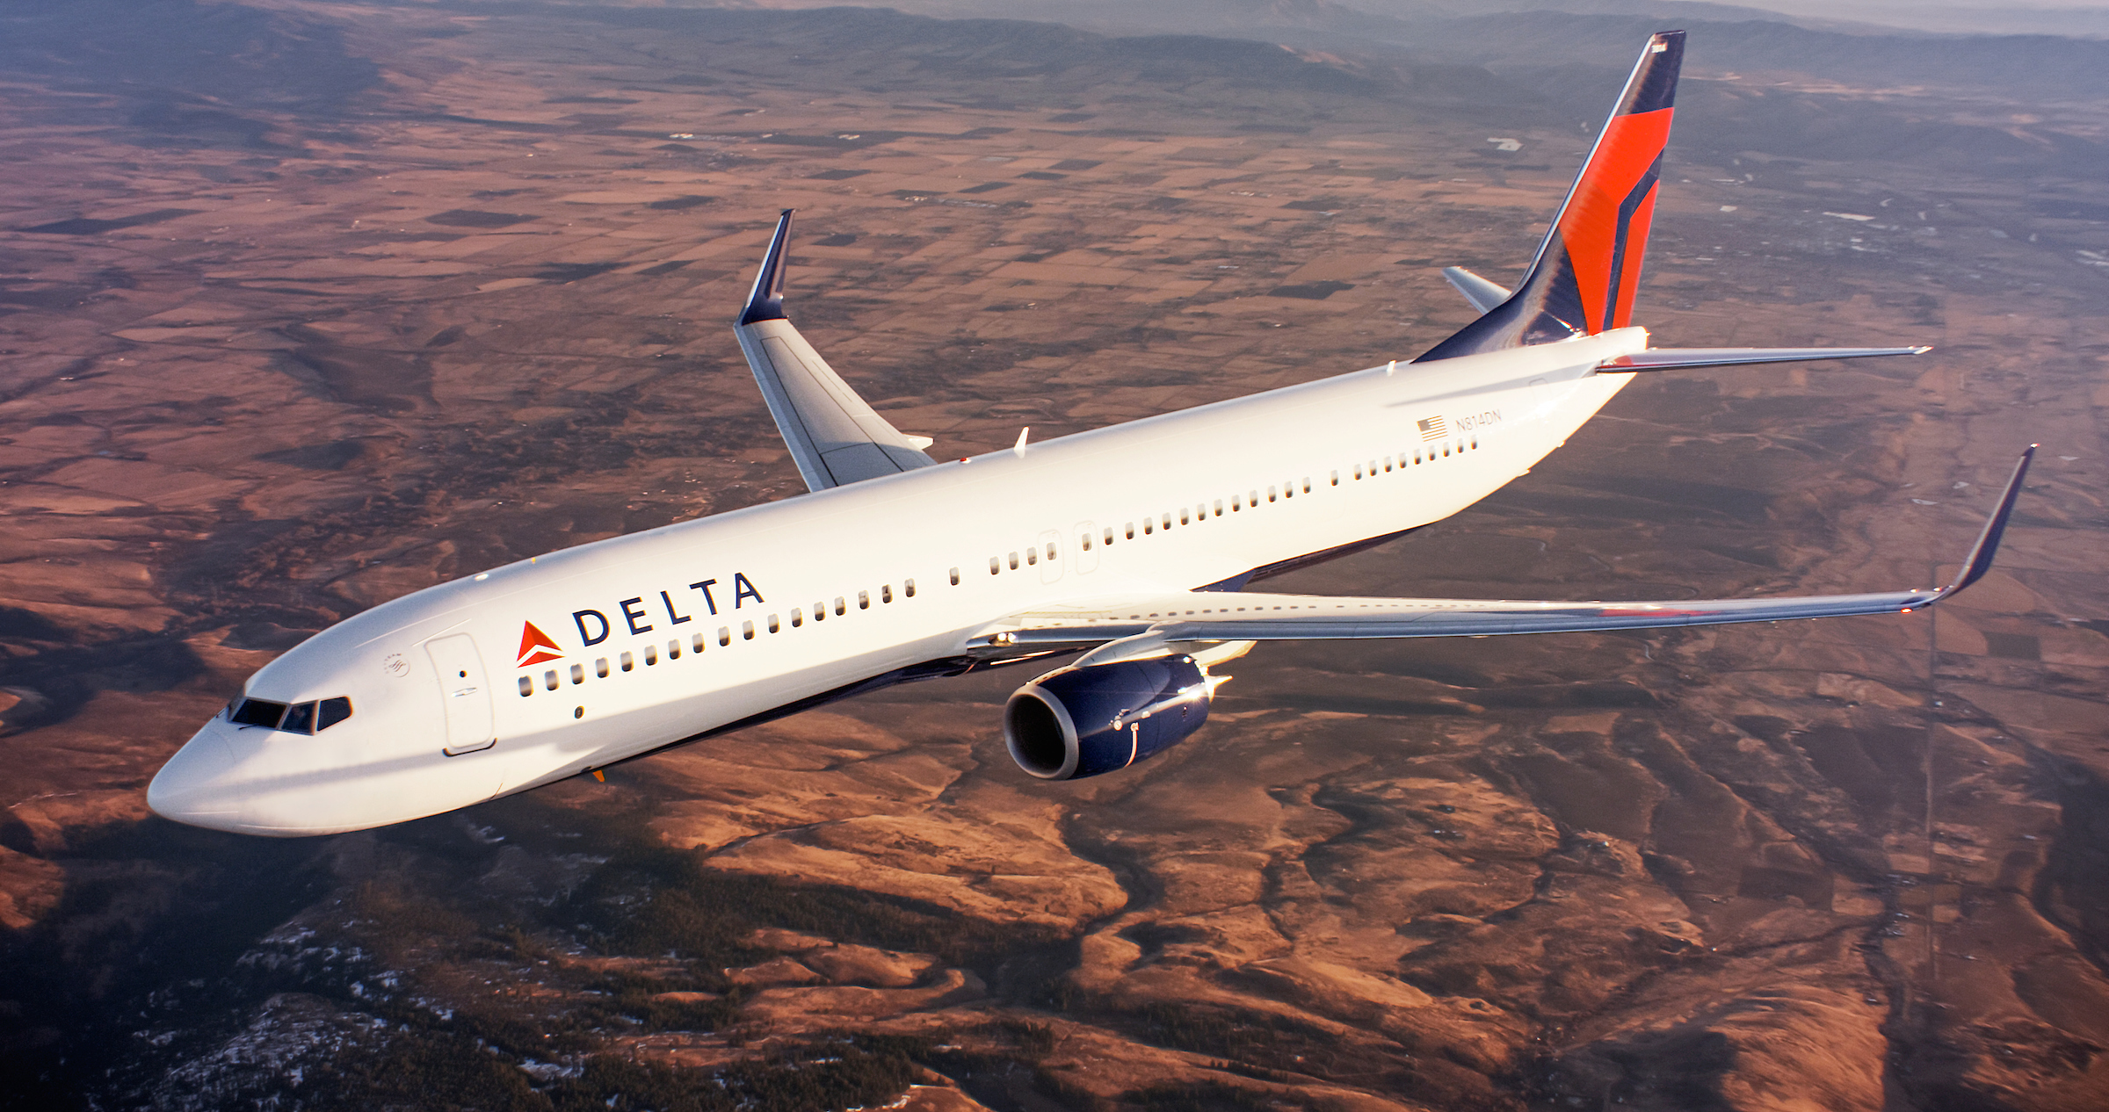
Problem Statement
News and Media outlet’s attack on Airlines
Delta’s efforts to address false allegations.
Notes:
Due to recent unfortunate airplane crashes, news and media outlets have circulated rumors surrounding airplane safety, claiming that air travel is no longer safe as a means of transportation. Therefore, the primary focus of the presentation is to shed light on airplane safety with accurate statistics and the impact Delta’s comprehensive safety program has on the safety of each passenger and crew member.

Slide 3
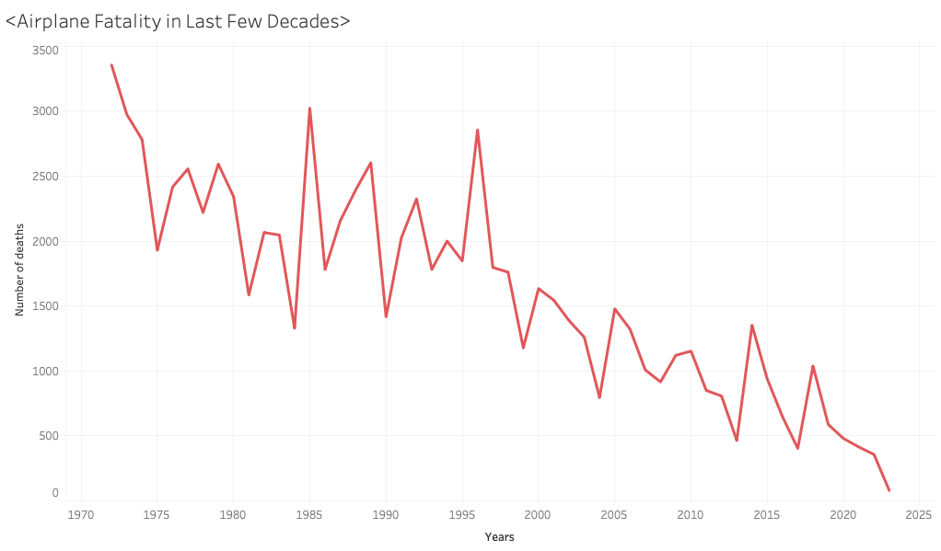
Airplane Fatality Rate
The fatality rate is in a downward trend in last 70 years.
The yearly average decreases from 2000 (1975 – 1999) to 550 (2000 – 2020)
1 in 11 million chance
Notes:
The historical data suggest that the global fatality rate has continuously decreased in the last 70 years. In fact, the yearly fatality average has decreased from 2000 to 550 death, a decrease of 263 percent. Fun fact, the odds of dying in an airplane is 1 in 11 million.

Slide 4
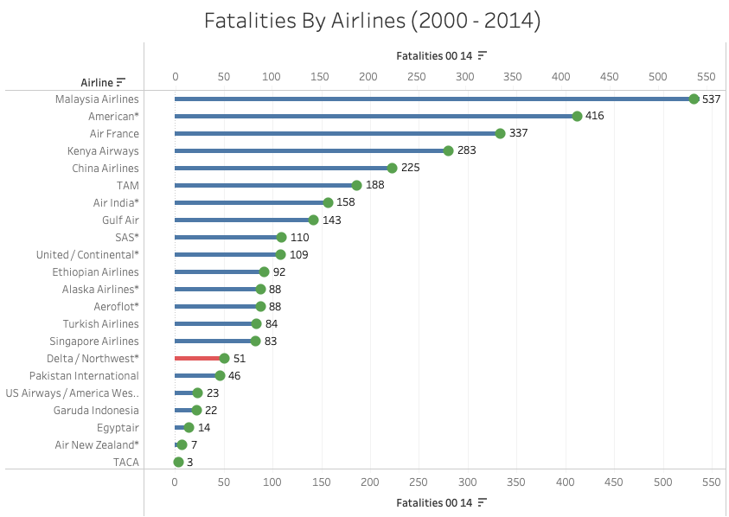
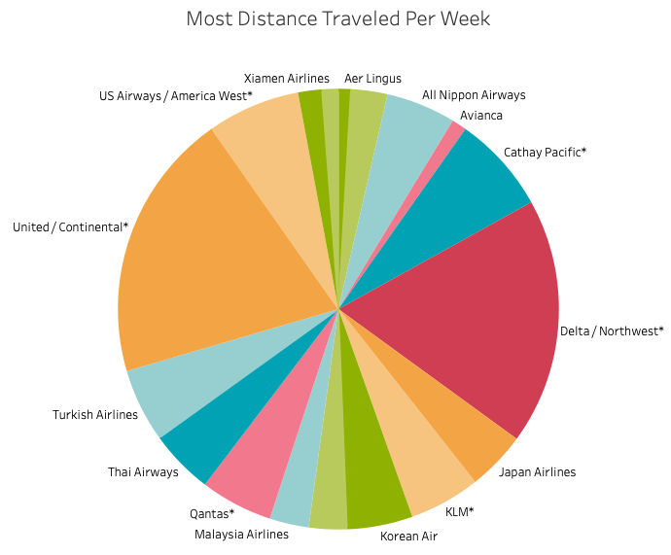
Delta Air Lines Compared to others
Ranked 2nd for the most distance traveled per week
Delta Air Lines ranked 16th amongst the airlines with most fatality
Notes:
By investing in modern and fuel-efficient aircraft, together with their advanced operations and management system, Delta Airlines has ranked 2nd for the most distance traveled from 2000 to 2014. Despite their extensive routes and hectic schedule, Delta doesn’t even rank in the top 15 amongst the airlines with the highest fatality rate.

Slide 5
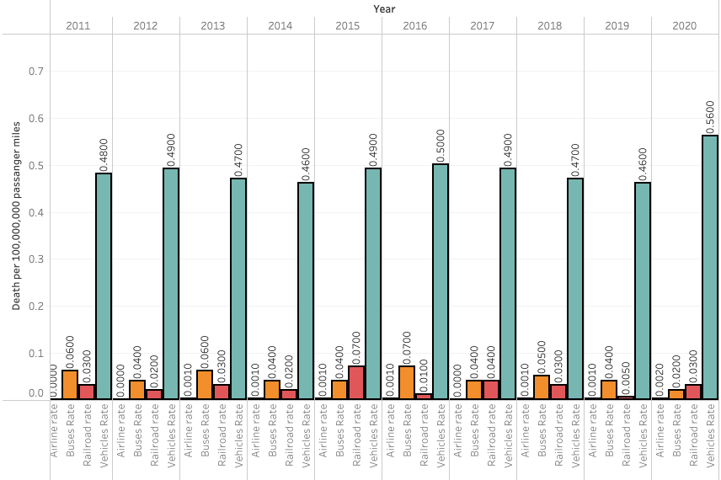
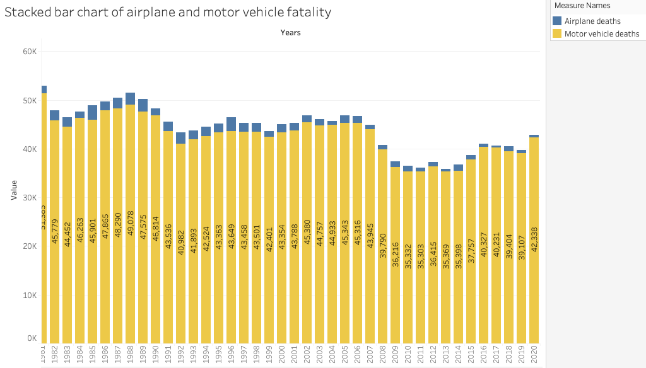
What about Other Types of Transportations?
Death per 100 million passenger miles across other transportations in 2020:
Cars: 0.5600
Buses: 0.0300
Railroads: 0.0200
Airplanes: 0.0020
Motor vehicle and airplane fatalities bar chart highlights the danger of using motor vehicles as a means of transportation.
On average: 102 car death daily compared to 1 airplane death
Notes:
Looking at the top chart which shows death per 100 million passenger mile for different types of transportation, it is evident that airplanes are the safest means of transportation, especially compared to cars. The bottom stacked bar chart clearly highlights the disparity in yearly fatality between the two. Note that the comparison is between yearly car death in the U.S. and the airplane deaths globally. On average, 102 die in a car crash daily in the US compared to less than one airplane death.

Slide 6

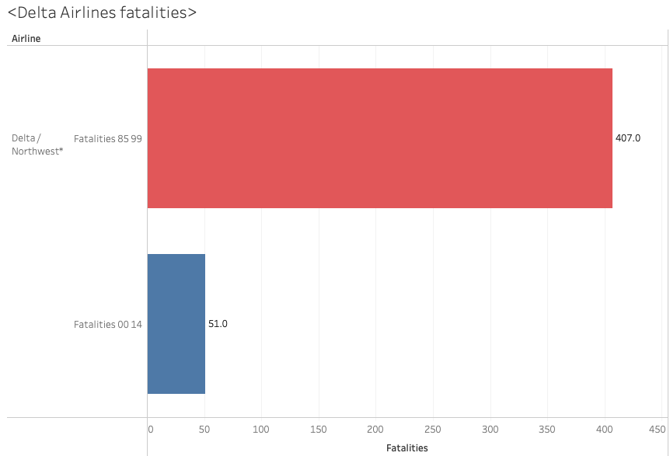


Delta’s Approach
Advanced Technology
Rules & Regulations
New Partnership
Fatality: 1985 – 1999 (red) & 2000 – 2014 (blue)
Notes:
So, you might be wondering how did Delta Airlines achieve this? Well, Along with our highly trained pilots, each Delta aircraft utilizes state-of-the-art technology and equipment to ensure the safety of our passengers. Delta also collaborates with other airlines and government agencies, such as the Federal Aviation Administration (FAA), to be well-informed about industry best practices and the latest safety regulations. After all, Delta Air Lines has significantly improved its safety practices and will continue prioritizing the safety of its passengers and crew members.

Slide 7

The End
Questions, comments, or concerns.
Notes:
Now that we have reached the end of the presentation, any questions, comments or concerns?

Slide 8
Reference
Impact | Airlines for America. https://www.airlines.org/impact/
Fivethirtyeight. “Data/Airline-Safety at Master · Fivethirtyeight/Data.” GitHub, https://github.com/fivethirtyeight/data/tree/master/airline-safety
“Deaths by Transportation Mode.” Injury Facts, 27 Apr. 2022, https://injuryfacts.nsc.org/home-and-community/safety-topics/deaths-by-transportation-mode/
Media, NHTSA. “Newly Released Estimates Show Traffic Fatalities Reached a 16-Year High in 2021.” NHTSA, NHTSA, 17 May 2022, https://www.nhtsa.gov/press-releases/early-estimate-2021-traffic-fatalities
Dailymail.com, Stacy Liberatore For. “Seat by Seat, Scientists Reveal Your Risk of Dying on an Airplane If It Crashes.” Daily Mail Online, Associated Newspapers, 6 Feb. 2023, https://www.dailymail.co.uk/sciencetech/article-11718755/Seat-seat-scientists-reveal-risk-dying-airplane-crashes.html

